Slide 1
Azure Stream Analytics
Microsoft Research

Slide 2
Azure Stream Analytics
Fully managed cloud-based service for analyzing high-volume, high-velocity, highly dynamic data streams
Uses SQL-like query language to make analyzing real-time data no more difficult than querying SQL databases
Requires no code, unlike Apache Storm and Amazon Kinesis
Easily scales up and down using Streaming Units
1 Streaming Unit = Approximately 1 MB/sec of throughput
Max available units = 48 (more available on request)
Perfect for analyzing data emanating from Internet of Things (IoT) devices, applications, Web sites, and more

Slide 3
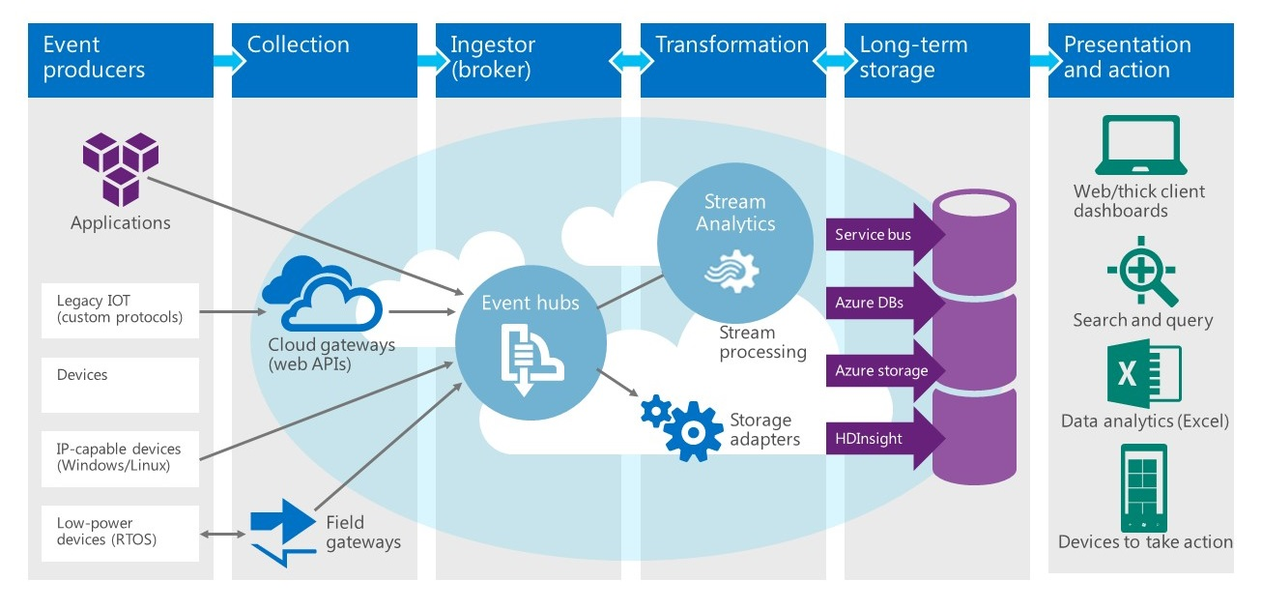
Stream Analytics at Work

Slide 4
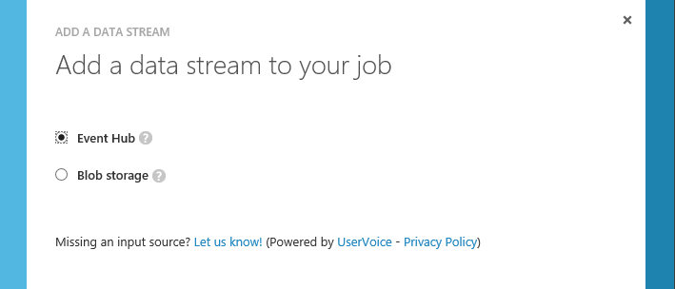
Stream Analytics Input
Stream Analytics supports two types of input
Multiple inputs can be JOINed (aggregated) like SQL tables
Also allows reference data to be provided as input

Slide 5
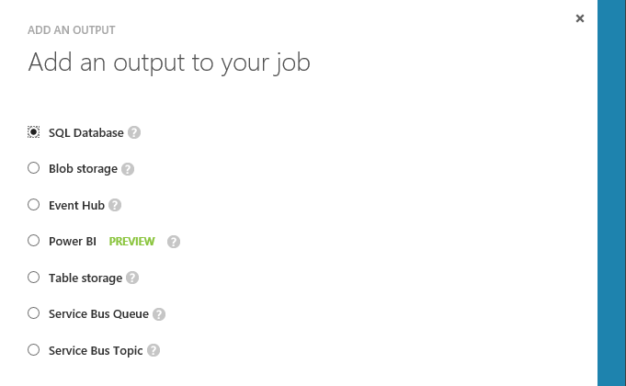
Stream Analytics Output
Supports several output types as well as multiple outputs

Slide 6
Demo
Creating a Stream Analytics Job

Slide 7
Stream Analytics Query Language
SQL-like language for querying live data streams
Subset of T-SQL
Supports bigint, float, nvarchar(max), datetime, record, and array
Supports SELECT, FROM, WHERE, GROUP BY, and other common Data Manipulation Language (DML) statements
Supports COUNT, AVG, DATEDIFF, and other common functions
Supports temporal grouping of events via "windowing"
Reference located at https://msdn.microsoft.com/en-us/library/azure/dn834998.aspx

Slide 8
Data Manipulation Language (DML)
SELECT
INTO
FROM
WHERE
GROUP BY
HAVING
CASE
JOIN
JOIN
UNION
WITH
APPLY

Slide 9
Selecting Data from an Input
SELECT Time, ID, Temperature
FROM TemperatureData
WHERE Temperature > 150

Slide 10
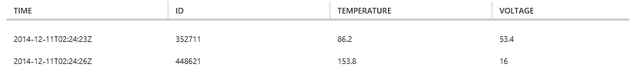
Joining Two Inputs
SELECT S1.Time, S1.ID, S1.Temperature, S2.Voltage
FROM TemperatureData S1
JOIN VoltageData S2
ON S1.ID = S2.ID
AND DATEDIFF(s, s1, s2) BETWEEN 0 AND 5
WHERE S1.Temperature > 150 OR S2.Voltage > 32

Slide 11
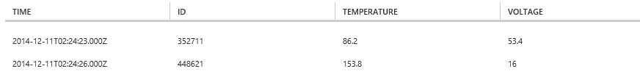
Replacing Arrival Time with Event Time
SELECT S1.ID, S1.Temperature, S2.Voltage
FROM TemperatureData S1 TIMESTAMP BY Time
JOIN VoltageData S2 TIMESTAMP BY Time
ON S1.ID = S2.ID
AND DATEDIFF(s, s1, s2) BETWEEN 0 AND 5
WHERE S1.Temperature > 150 OR S2.Voltage > 32

Slide 12
Windowing
Core requirement for stream-processing systems for counting or aggregating events in a specified time period
Tumbling Window
Hopping Window
Sliding Window

Slide 13
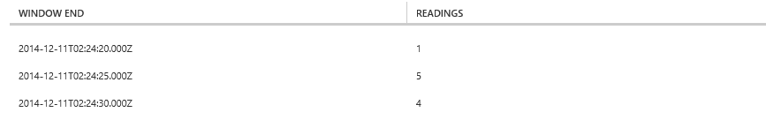
Using TumblingWindow
SELECT System.Timestamp as [Window End],
COUNT(*) AS Readings
FROM TemperatureData TIMESTAMP BY Time
GROUP BY TUMBLINGWINDOW(s, 5)

Slide 14
Demo
Stream Analytics Queries

Slide 15
Hands-On Lab
IoT and Azure Stream Analytics
StreamAnalyticsHOL.pdf

